Slide 1


HELPING TO LOOK AFTER THE PEOPLE YOU CARE ABOUT
Anna Luczyna
Working Carers Development Officer
CARERS RIGHTS
AT WORK
Rowan Preston
Carers Wellbeing Advisor
Notes:
https://www.time-to-change.org.uk/sites/default/files/imce_uploads/Family%20Matters.pdf
https://www.cochranelibrary.com/cdsr/doi/10.1002/14651858.CD004366.pub6/full?cookiesEnabled

Slide 2


CARERS RIGHTS AT WORK
In this session we will discuss:
• Your statutory rights at work;
• New laws to support working carers;
• Speaking to your employer about your caring role;
• Accessing support;
• Questions?

Slide 3

AM I A CARER?
“A carer is anyone who cares, unpaid, for a friend or family member who due to illness, disability, a mental health problem or an addiction cannot cope without their support.”

Slide 4

WHO ARE CARERS?
Becoming a carer can happen to anyone and at any time.
Out of 10 people, how many do you think will end up caring for someone by the age of 50?
  2 out of 10?
  3 out of 10?
  5 out of 10?

Slide 5

CARING CAN BE:
Physically and mentally exhausting
Isolating and lonely
Constant battle to get people to understand
A financial struggle
Combining work and caring

Slide 6

WORKING CARERS
There are 5 million people combining caring for a loved one with paid work in the UK.
That’s 1 in 7 workers.
1 in 4 working carers have considered giving up their job entirely because of the stress of balancing work and care.
Source: Fact about Carers, Carers UK

Slide 7

EMPLOYMENT
LAW

Slide 8

YOUR RIGHTS
Statutory rights which everyone has
Contractual rights
Check your contract of employment, staff handbook or HR policies to see if you have any contractual rights on top of your statutory rights.

Slide 9

STATUTORY RIGHTS
Right to request flexible working
Carer’s Leave Act
Time off in emergencies
Protection from discrimination
Parental leave

Slide 10

FLEXIBLE WORKING
Can help carers to manage their responsibilities both at work and at home, and achieve positive outcomes for employers
You can request flexible working from day one of your employment
Two requests per year
Your employer will have to consult you if they don’t think they can make the changes you need.

Slide 11

FLEXIBLE WORKING
Part-time;
Working from home or hybrid working;
Compressed/condensed hours (where you work full-time hours over fewer days);
Flexi-time (where workers can choose their start and finish times within agreed limits);
Staggered hours (where you have different start, finish and break times from other workers);
Job sharing (where two people do one job and split the hours).

Slide 12
FLEXIBLE WORKING
Flexible working requests can be refused only due to good business reasons set out in the law:
Extra costs that will damage the business.
The work cannot be reorganised among other staff.
People cannot be recruited to do the work.
Flexible working will affect quality and performance.
The business will not be able to meet customer demand.
There’s a lack of work to do during the proposed working times.
The business is planning changes to the workforce.

Slide 13

REQUESTING FLEXIBLE WORKING

Slide 14


CARERS UK RESOURCES
“Let’s talk about flexible working” guide from Carers UK

Slide 15

CARER’S LEAVE ACT
Employees are entitled to one week’s unpaid leave per year if providing or arranging care for someone with a long-term care need.
It is available from the first day of employment
Can be taken flexibly (in half or full days)
For planned commitments – needs to be requested at least 3 days in advance

Slide 16
CARER’S LEAVE ACT
This includes if you are caring for someone with a physical/mental illness/injury/ disability/old age
Family member or someone else who relies on you for care
You do not have to provide evidence of your caring role

Slide 17

CARER’S LEAVE ACT
Intended to cover a range of caring situations, for example:
Taking someone to a medical appointment
Supporting someone with personal care
Arranging visits with health professionals
Organising care for the future.

Slide 18

TIME OFF IN EMERGENCIES
“Reasonable” time off to deal with an emergency or unexpected situation involving a dependant
This may be your partner, child, parent, someone living with you as part of your family (others who rely on you for help in an emergency may also qualify)
Paid at the employer’s discretion

Slide 19

EXAMPLES OF EMERGENCY SITUATIONS
a disruption or breakdown in care arrangements
the death of a dependant
if a dependant falls ill or is in an accident
To make longer-term arrangements for a dependant who is ill or injured (but not to provide long-term care yourself)
an incident involving a child during school hours

Slide 20

PROTECTION FROM DISCRIMINATION
The Equality Act 2010 gives carers protection against discrimination by reason of their association with someone who is protected by the law because of their age or disability
E.g. not offering them a job, promotion or training opportunity; harassment/bullying; social/professional exclusion.

Slide 21
RIGHT TO PARENTAL LEAVE
If you have worked for the same employer for 12 months and you are responsible for a child aged under 18, you are entitled to 18 weeks’ leave per child
This time off is unpaid unless your employer is willing to give paid time off as a contractual right.

Slide 22
RIGHT TO PARENTAL LEAVE
Leave can be taken in blocks of a week, or a day if the leave is to care for a disabled child
Usually up to a maximum of four weeks a year
You must give at least 21 days' notice to your employer to take parental leave and the leave must be taken by your child's 18th birthday.

Slide 23

EMPLOYMENT LAW SUPPORT
HR/personnel department
Union or staff representative
Central England Law Centre
https://www.centralenglandlc.org.uk/

Slide 24

SPEAKING TO
YOUR EMPLOYER

Slide 25

TALKING ABOUT YOUR
CARING ROLE AT WORK
There may be existing support that you are not aware of
Try to have the conversation early on
You could also talk to your colleagues, HR or union representative

Slide 26

PREPARE FOR THE CONVERSATION
Think about what you are willing to share
Think through the options
Write down what you want to talk about
Try to be flexible
Be open to trying things on a temporary basis
Write down what you agree to

Slide 27

CARER PASSPORTS
A Carer Passport is a written record of your caring role and the support available to you
All resources are available for free at
www.carerpassport.uk/employment/

Slide 28
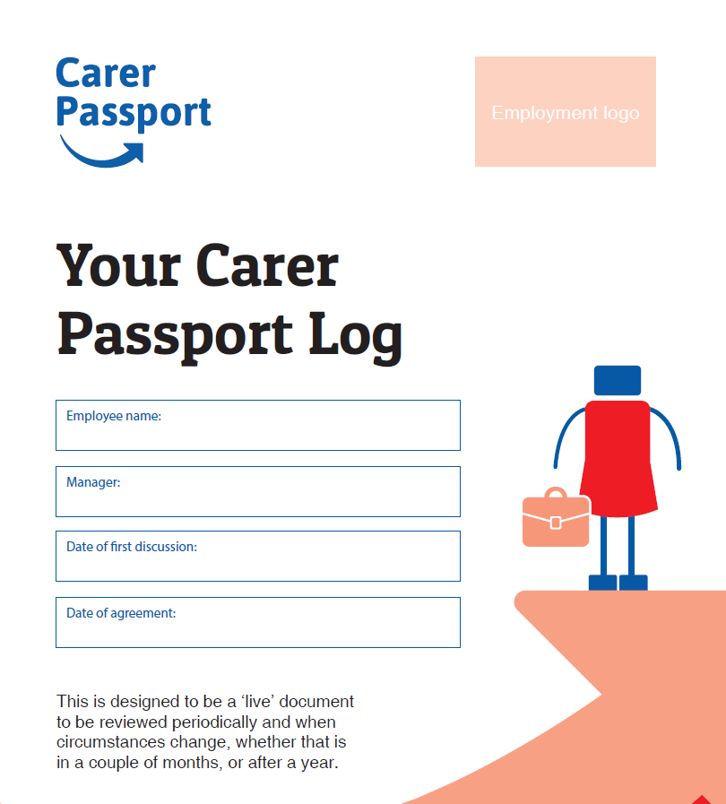
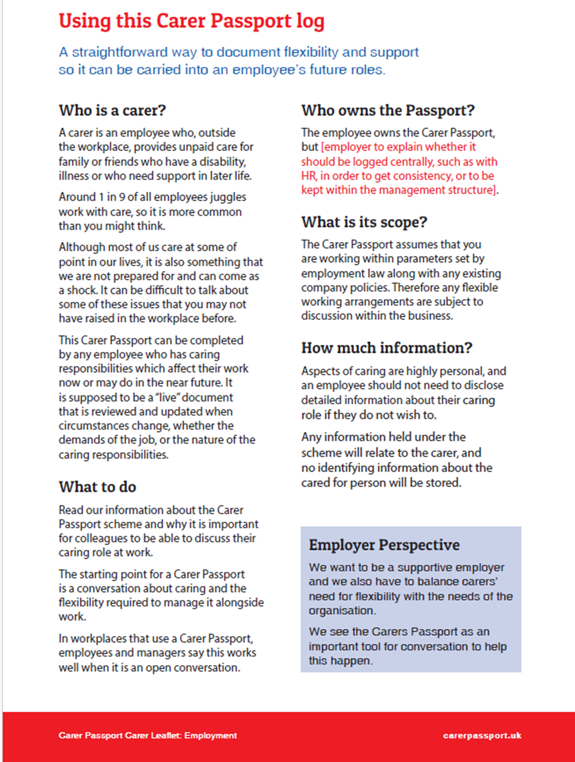

Slide 29
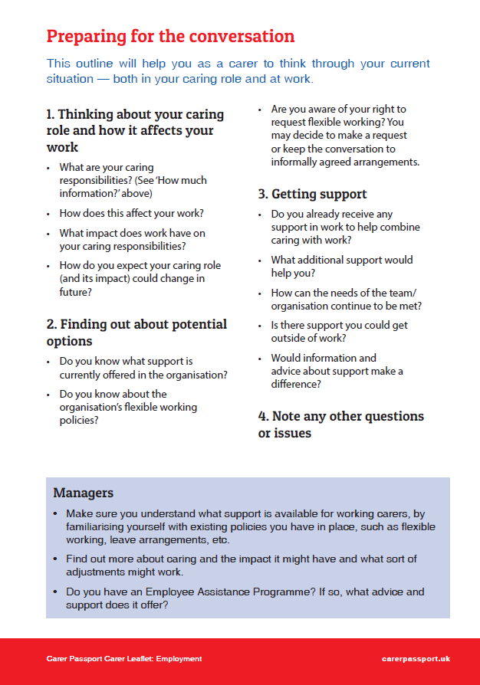
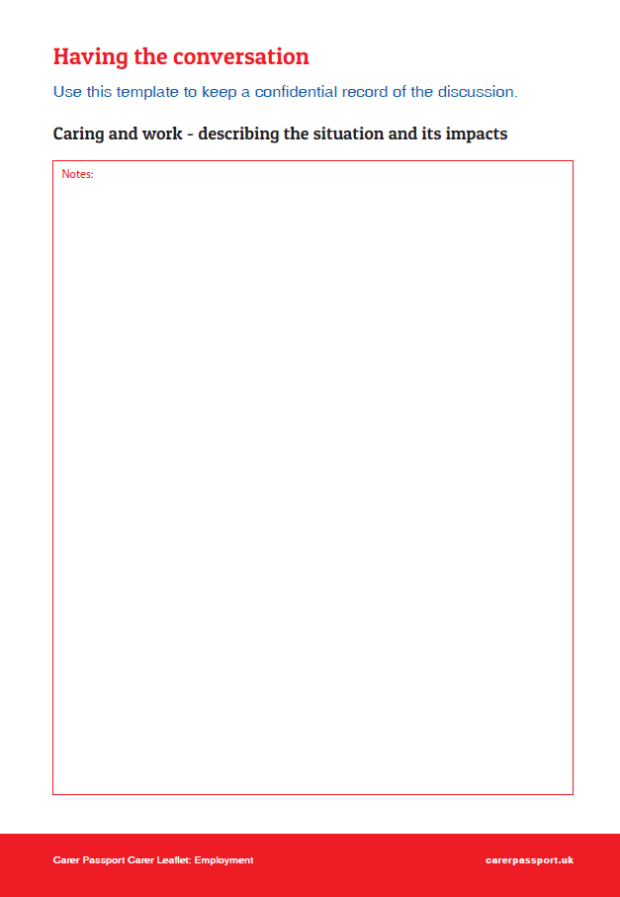

Slide 30
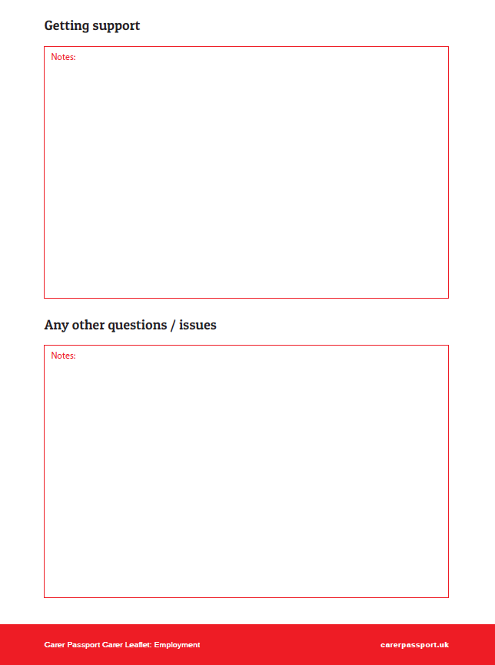
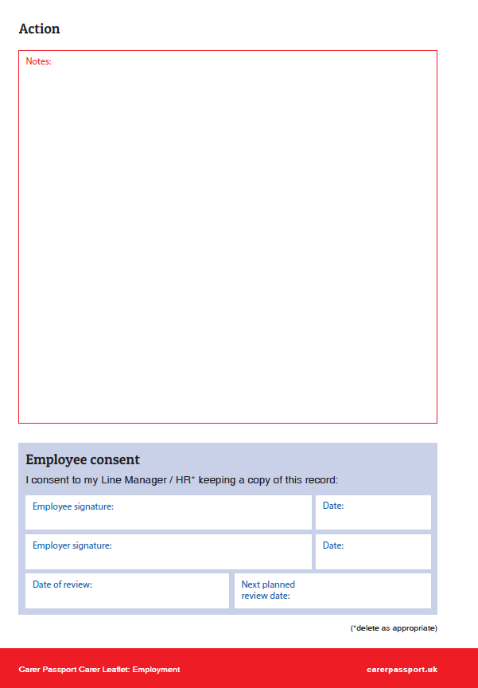

Slide 31

ACCESSING
SUPPORT

Slide 32

CARERS TRUST SERVICES
Carers Assessments
Carers Response Emergency Service (CRESS)
Support/social groups
Wellbeing sessions
My Time project
Counselling
Carer Money Matters Project
Regulated services (DayBreak, home support)
Signposting

Slide 33

RESOURCES FOR CARERS
Balancing Work and Care booklet
Carer aware course
Coventry City Council’s Carers e-bulletin
All Carers registered with us entitled to a Go CV+ Card
Carers Rights Podcast

Slide 34

OTHER ORGANISATIONS
Coventry and Warwickshire MIND
Age UK
Adult Social Care
Admiral Nurses
Coventry Independent Advice Service
Dementia Connect/Alzheimer’s Society
Sky Blues in the Community
Stroke Association

Slide 35
Thank you for listening
Any Questions?

Slide 36
CONTACT US
Anna Luczyna
email: anna.Luczyna@carerstrusthofe.co.uk
Rowan Preston
email: rowan.preston@carerstrusthofe.co.uk
For more information on our services,
please contact us using the below details:
Tel: 02476 632972
Email: contactus@carerstrusthofe.org.uk
Website: www.carerstrusthofe.org.uk

