Slide 1

Young Carers in
Primary Schools
Notes:
Intro song for assembly:
https://youtu.be/Yc6T9iY9SOU - Bruno Mars, Count on Me

Slide 2


WHO
ARE
‘YOUNG CARERS’?
Notes:
Ask the pupils their thoughts on what a young carer is?

Slide 3



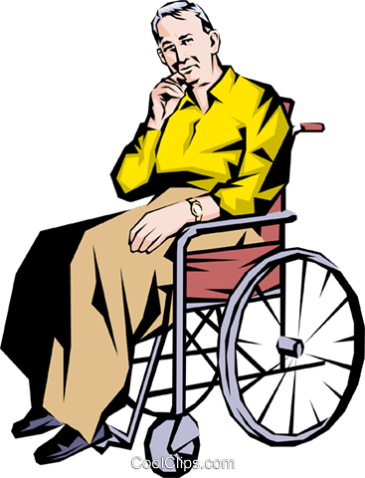
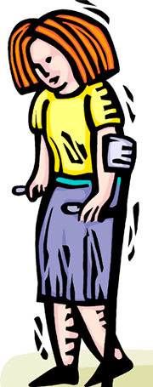

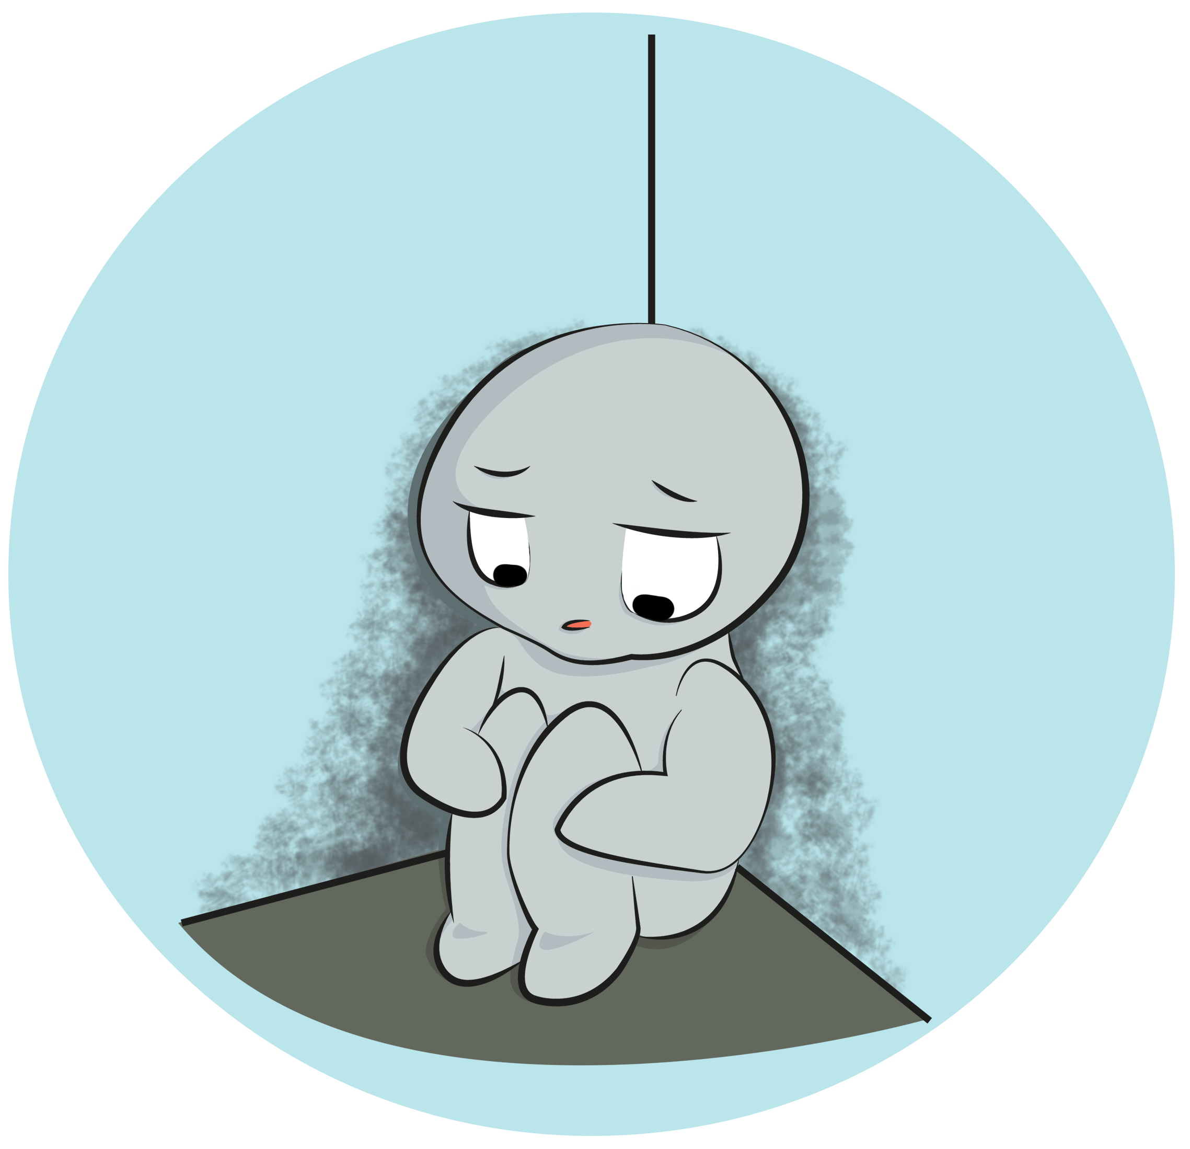
YOUNG
CARERS
Aged 5 – 18 years old
May care for mum, dad, carer, brother, sister, grandparent/s, friend or neighbour
Notes:
Explain that Young Carers can be anyone aged 5-18 years old
The Young Carers Service provides support up to 25years old.
There can be many reasons that young people and adults, become carers – this may be because a loved one has a long term illness, a disability, poor mental health, substance misuse issues or elderly/frail.
Young Carers do not need to live with the person they care for, such as grandparents. They may only visit once or twice a week to help out.

Slide 4
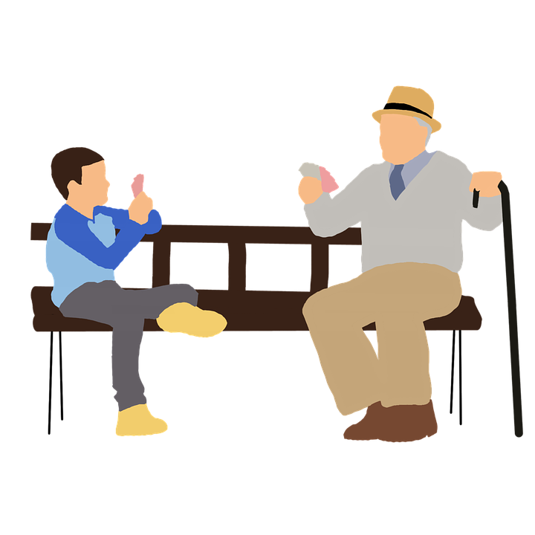
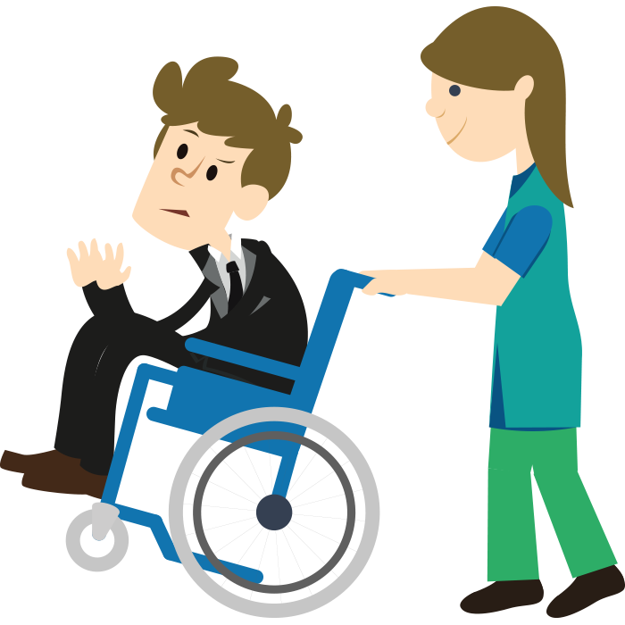
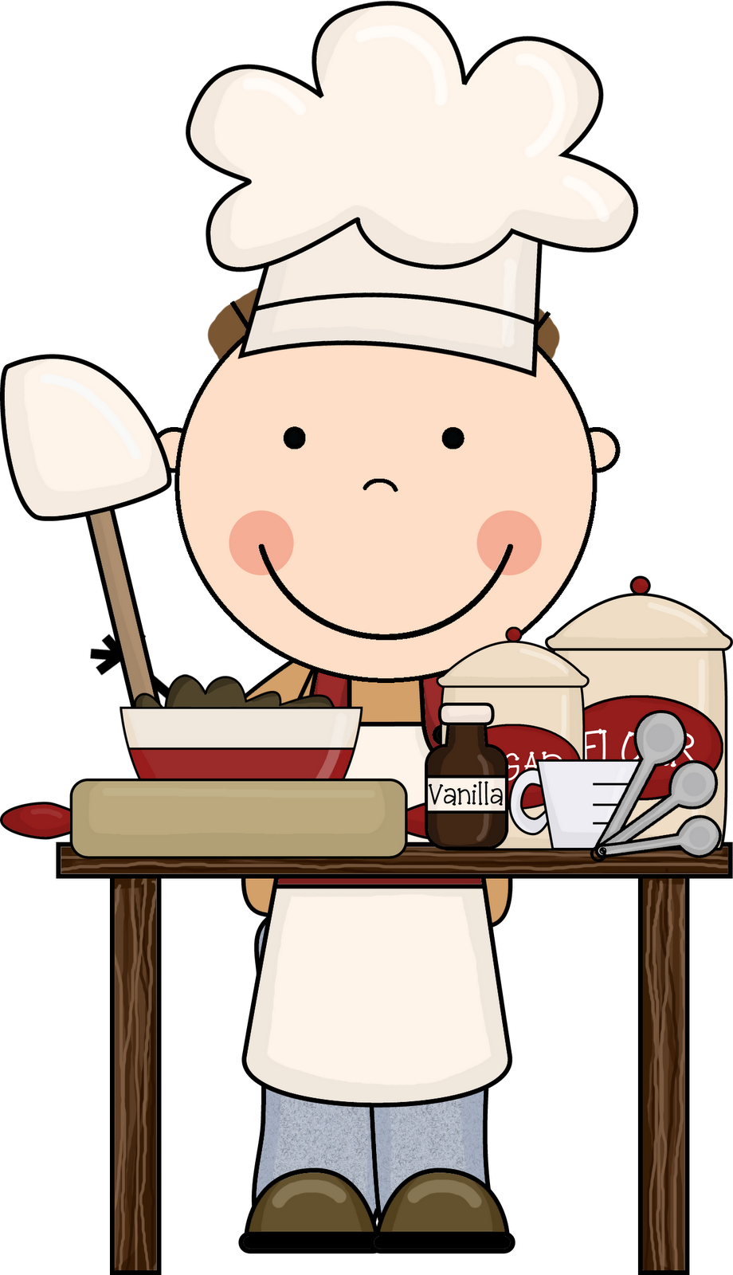
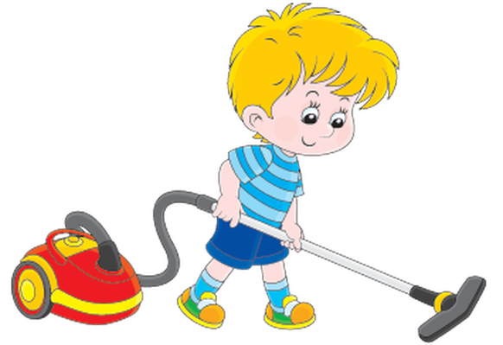

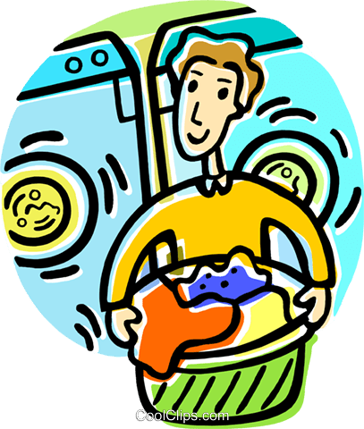
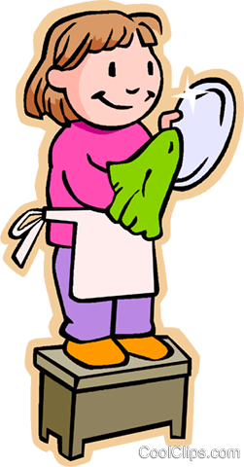

Notes:
Young Carers do different jobs, that may be similar to usual chores… but Young Carers do these more often.
This may include, emotional support – having a chat, making a cuppa and checking in
Doing housework – laundry, cooking, washing, hoovering etc.
Looking after siblings
Administering medicine and helping with personal care

Slide 5


Guess
the
Young Carer
(THUMBS UP/THUMBS DOWN)
Notes:
Introduce a short game of Guess the Young Carer
Thumbs up if you think the child in the scenario is a young carer, or thumbs down if you think not a young carer

Slide 6


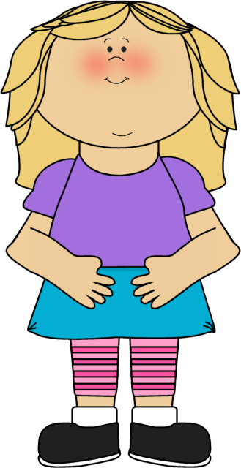


Is Olivia a Young Carer? Olivia is 9 years old, her grandma has dementia and can be very forgetful. Olivia visits Grandma on the weekends with her mum. Olivia gives her grandma a cup of tea and watches TV. Olivia also does the dusting to help clean up. Before heading home, Olivia reminds grandma to have her medicine by leaving a note on the fridge. | Is Jayne a Young Carer? Jayne is 5 years old. Her mum is very poorly with the flu, and Dad works very long hours which means Jayne has to look after mum for the week! Jayne has been giving mummy lots of water to drink and had to help when mummy was being sick. Jayne is also having to wake her mummy up to have her flu medicine. | Is Jas a Young Carer? Jas is 11 years old, he lives with his mum and dad. Dad is in a wheelchair and Jas sometimes has to help mum moving dad onto the sofa or into bed if he is having a bad day. He helps by pulling dad’s legs up onto the bed, or propping dad up so he is comfortable. He also helps by keeping dad company when mum is busy with chores or has to pop out to do the shopping.

Slide 7
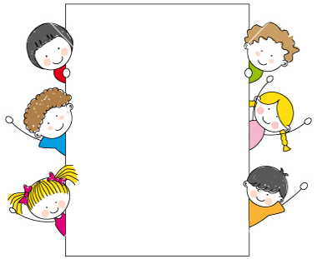
Meet other Young Carers
Make friends
Fun activities – youth clubs, movie nights, and cooking sessions
Trips and days out – to the seaside or to see a play!
Emotional support – if you’re feeling sad or confused, and would like somebody to talk to
Notes:
What the Young Carers service does

Slide 8

If you think you may be a young carer…
Speak to
      an adult in your school
someone you trust
someone from
the Young Carers Service
Notes:
Young carers service, Coventry can be searched on google
Provide the name of a staff member in school that children can speak to

Slide 9



